Slide 1
Conservative Management of a Grade 4 Sacral Pressure Ulcer in a Paraplegic Patient: A Case Report from Malindi Sub-County Hospital, Kenya 27TH ANNUAL SCIENTIFIC CONFERENCE 16TH OCTOBER 2025
Author: Sifa Mukare
Affiliation: Malindi Sub-County Hospital, Kilifi County

Slide 2
The feasibility of an operation is not the best indication for its performance.
Henry Cohen (1900–1977)

Slide 3
INTRODUCTION
Grade 4 pressure ulcers are severe wounds extending to muscle, tendon, or bone, associated with high morbidity and prolonged healing.
Standard management involves surgical debridement, yet in resource-limited settings, this may not be feasible.
Conservative approaches, though less commonly reported, may offer viable alternatives.
We present a case of successful conservative management of a Grade 4 sacral ulcer in a paraplegic patient at Malindi Sub-County Hospital.

Slide 4
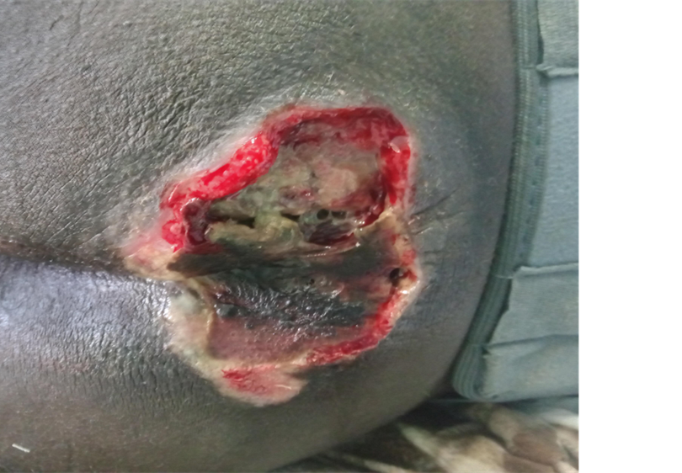
Case Presentation:
A 27-year-old male with paraplegia secondary to a motorcycle-related spinal injury presented with a chronic, foul-smelling sacral wound and urinary incontinence. Examination revealed a 10 × 10 cm Grade 4 sacral ulcer with necrosis, purulent discharge, and surrounding edema.

Slide 5
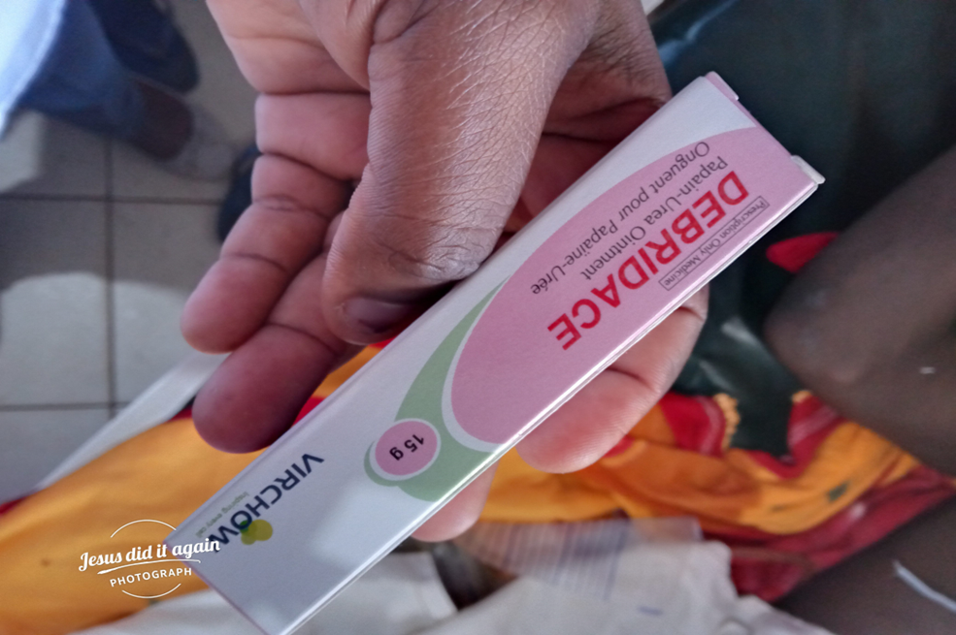
Therapeutic intervention:
Local wound care: Normal saline cleansing, antiseptic solution, enzymatic debridement with papain-urea ointment on alternate days.
Systemic therapy: Oral Clindamycin and Metronidazole for infection control.
Supportive care: High-protein diet, iron and vitamin supplementation, analgesia, repositioning every 2 hours, ripple mattress.

Slide 6
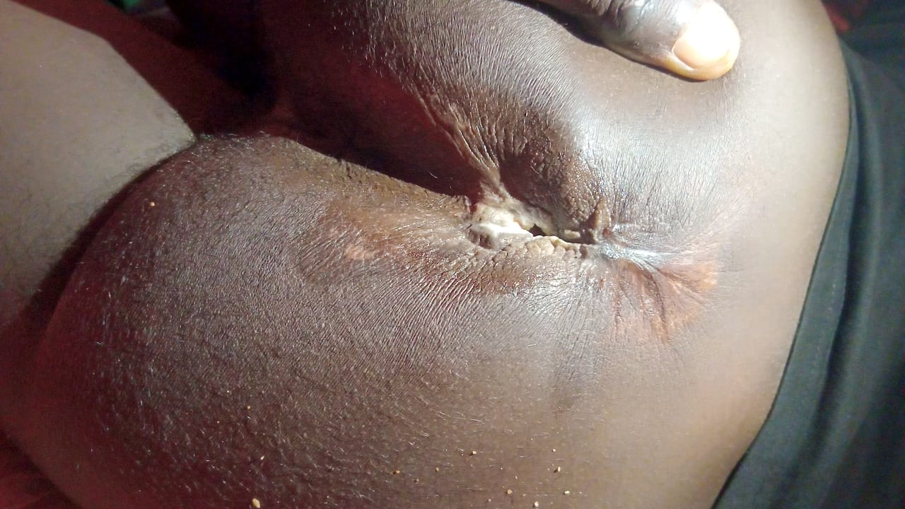
Outcome:
Over 8 months, the PUSH Tool 3.0 score improved from 17 to 11, indicating significant reduction in wound size from 100cm² to 36cm², necrosis, and exudate. The patient remained clinically stable and attended follow-up clinics bi-monthly.”

Slide 7
Conclusion:
This case demonstrates that even advanced Grade 4 pressure ulcers can be successfully managed conservatively when surgical options are unavailable.
Multidisciplinary, structured non-surgical management—combining wound care, infection control, nutritional support, and pressure offloading—can yield meaningful recovery in resource-constrained settings.

Slide 8
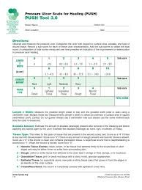
PUSH Tool 3.0 score for pressure ulcers

Slide 9
“It is more difficult to decide when not to operate than when to operate and what operation to perform,“

